Slide 1
Developing a Formative Assessment of Instruction for the Foundations of Computing Stream
2013/04/08
Steve Wolfman
UBC CS
Acknowledgments: Help, data, and input from many faculty and students at UBC.
Notes:
ABSTRACT: Pedagogy is changing quickly in CS and apparently for the better, but how do we know how it affects students' understanding of core concepts and skills? Science education assessment in several disciplines has benefitted from simple, broadly usable tools like the Force Concept Inventory. In this talk, I'll discuss my ongoing work identifying and studying core concepts in UBC's "Foundations of Computing" (FoC) sequence--AKA the required undergraduate "theory" courses--and developing from this a short multiple-choice assessment instrument. I will discuss the ideal end product, describe the methodology I am using, and present preliminary results from student and instructor interviews on FoC topics that are broadly accepted as important.

Slide 2
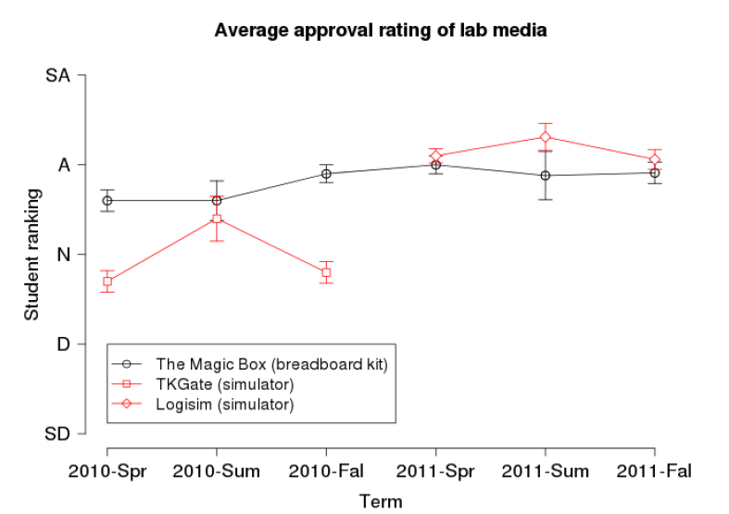
Inspiration
From Patitsas and Wolfman, SIGCSE 2012
From Mazur, Int’l Newsletter on Physics Ed, Apr 1996
Notes:
Mazur: http://www.physics.umd.edu/icpe/newsletters/n32.htm

Slide 3
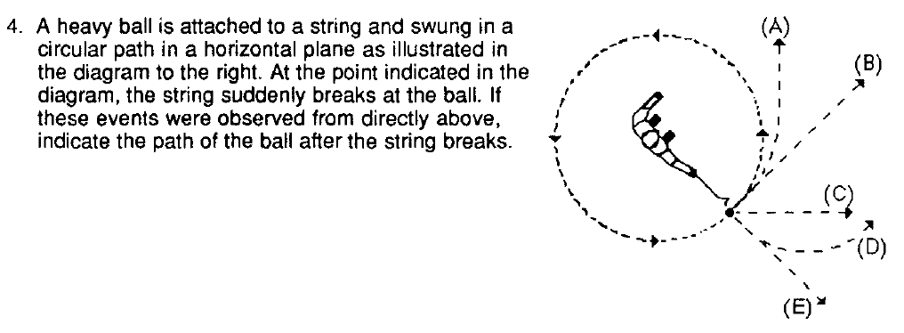
Ideal Goal
Sustainable assessment as a “thermometer” for health of the courses.
What makes it sustainable? Let’s look at the FCI:
29 multiple choice Qs and takes 23.3 minutes
Founded on previous/ongoing physics ed. research
Focuses on a few key topics
Deliverable on paper (if needed!)
From Hestenes, Wells, and Swackhamer, Physics Teacher Mar 1992
Notes:
Cautionary note: Do students have preconceptions, physically-based notions of FoC concepts? Are they clean slates?
Hestenes, Wells, and Swackhamer: http://cird.unive.it/dspace/bitstream/123456789/317/2/Forced_concept_inventory.pdf
Hake: http://web.mit.edu/rsi/www/2005/misc/minipaper/papers/Hake.pdf

Slide 4
Methodology
Gather goals by interviewing faculty involved in the stream
Augment & winnow goals by analysis of exam results
Draft questions to assess key goals
Validate expert responses to questions
Collect student misconceptions in think-aloud interviews
Formulate forced-answer versions of Qs based on student responses
Validate forced-answer Qs in think-aloud interviews
Pilot assessment, confirming reliability and validity
General use for assessment of courses, longitudinal analysis, etc.
Notes:
Adams-Wieman_FASI_IJSE2010
iticse-2006-working-group-concept-inventory-why-to-how-to-p132-almstrum

Slide 5
Grand Goals…
How do we assess these??
What are the key learning goals for the Foundations of Computing stream?
Recursive/inductive thinking
Analysis of resource (time, space, energy, …) costs of solutions
Formalization/specification of ill-specified problems
Comfort with “dense” formal descriptions
Proposal and explanation of multiple solution approaches to a problem
Meta-cognitive management of the solution process
Generalizing/abstracting problems/sol’n properties
Notes:
Interviews (analysed) w/10 of the 14 faculty who taught the "foundations of computing" stream courses in the past three years.
Ask them how to assess these. Ask them how to assess these in a closed-ended MC format.
Notes on successful/unsuccessful instructor interviews:
The trouble in my least productive interview was that the instructor and I enjoy chewing over big, philosophical issues. That's a fabulous and important pastime, but the point of these interviews was really to get the concrete specifics to form an assessment that can fuel that pastime, not to engage in it.
The best part of the interview was the moment when, looking at an old exam problem, the instructor pointed out a problem students faced with a simple question (determining whether a node is in the left subtree/right subtree of an ancestor or, more likely, determining that it's important and recognizing it). This is a moment fueled by a specific observation of a difficulty students had and a theory as to why in the context of a very concrete problem.
Again, this reinforces the trouble we both had, because we'd often dismiss problems where students did badly by, basically, saying "sure, I'd probably do badly there as well". *BUT*, it's not clear that the students were doing badly for the reasons we imagined. We were too focused on the high level and not sufficiently focused on what the data were telling us.
Conversely, in two of my most productive interviews, the instructors had a broad set of example problems on hand that they could use to fuel discussion in a very concrete way. This led to a laundry list of issues tightly coupled with example problems that might probe these issues.
Moral of the story: Try to get people to look through an old exam or two *before* you see them!
The LiveScribe pen was extremely useful. I didn't actually heavily use my written notes except to orient myself while relistening, but I /did/ love using the high-speed playback. It made it so I could actually finish reviewing my nine interviews in a single day!

Slide 6
…to Assessable Goals (?)
“Think about times when you cringe inside because your students just don’t get something that seems very important to you, and which you expect any expert to get.”
+
Quick review of low-/mid-/high-scoring exams.
Induction (6/2/-1): “should be able to do .. themselves from scratch without requiring additional input”
Divide & Conquer / Recurrences / Dynamic Programming (4/0/-3): “express the solution to a problem in terms of subproblems”
Logarithmic Tree Height (3/0/-0): “How many times can I give away half my apples before being left with just one?”
…
Notes:
Here’s a history of (some of the) prompts used in my second round of instructor interviews.
PB: I think the best way to describe what I'm looking for is places where you sort of feel like you want to cringe because you keep seeing students doing something that feels non-expert, feels naive to you on some important problems.
AH: What are things that students have trouble with that make you cringe? Places where you feel like this is really important, an expert knows how to do this and does it very differently from the way that students are doing it.
EK: What is it that you find cringe-worthy that students have trouble with, where their thinking is very non-expert-like but you'd expect them to get it?
MA: What are the times when you kind of cringe inside because your students just DON'T get something that seems very very important to you, where their thinking is just not expert?
WE: [No opening Q; instead, worked from areas of difficulty on recent exams, which was great.]

Slide 7
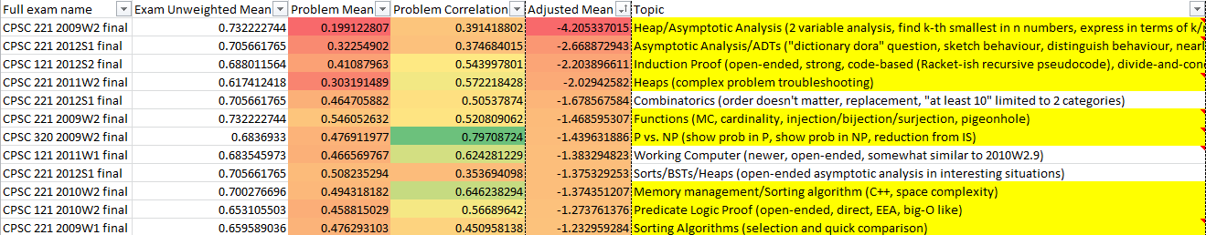
Exam Analysis: Low Mean
For each question: average and standard deviation on the question,
Strategic snippets of the worst-performing,
High Correlation
Notes:
Students have done terribly on strong induction but weak induction is sometimes quite bad and sometimes fairly good. Clearly, both are worth assessing to understand how changing instructional strategies affect students’ performance.
Besides induction, various topics show up below the mean, such as Working computer-related problems, predicate logic proof, predicate logic translation, and DFA <-> sequential circuit problems.
Almost anything concrete shows up well above the mean, e.g., set and function problems, propositional logic evalution or straightforward
equivalence, number rep, etc.
Of the high correlation problems, one is unsurprising: the aggregate of the many MC questions in 2009W1.
Other strong correlates include:
+ some of the strong induction problems
+ the functions problem (perhaps b/c they're end-of-term material?? perhaps b/c they integrate many concepts? surprising!)
Filtering to high correlates on which students did reasonably well (better than mean on that exam), we get:
+ functions MC
+ functions proof
+ DFAs <-> Seq'l Circuits
+ Predicate logic proof
+ an induction proof (weak)
+ set proof
+ predicate logic translation
Not sure what to say from this. MANY of the high correlates are those on which students did poorly, not well.

Slide 8
Interview Analysis Examples

Slide 9
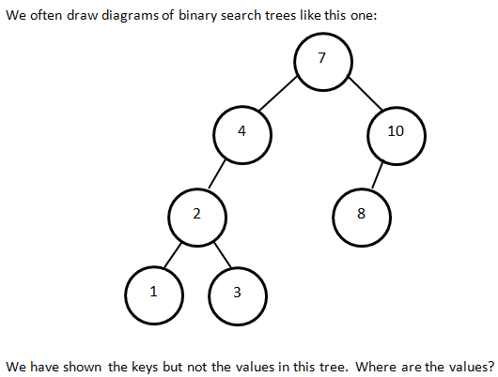
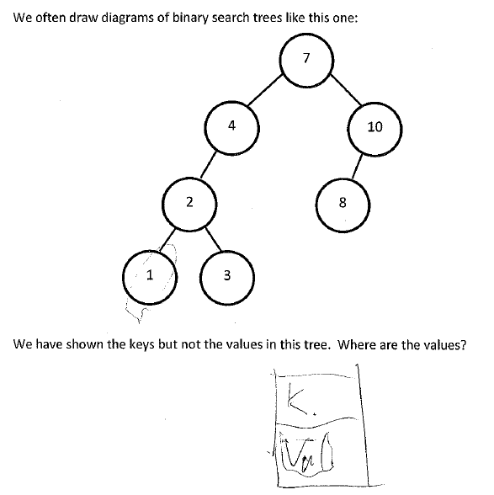
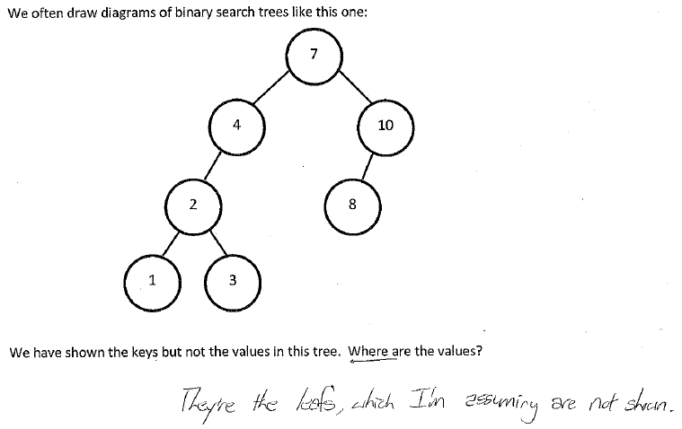
“the values are pointed to or stored in the same node object”
“The value [are] stored in these bubbles”
“the values would reside in memory or on disk”
“So the values are.. in the nodes”
"it could just be an array … and … the keys could just be the indices of a giant array"
“the values should be 1, 2, 3, 4, 5, so they're index values … 6, 7, 8”
“… an array … the keys could just be the indices of a giant array”
“[the key is] a lookup for the value”
“the values are being represented in the tree by the keys. So knowing … the key like unlocks … what the value is”
“the values would actually be in the leafs”
that's a weird list of.. numbers. So you're missing.. missing 5 and 6.. and 9
So the values are.. in the nodes I guess is how I'd answer that. Cause they kinda.. it's where you stop searching and that's your value or it's a lookup for the value, and that's what the key is for
Notes:
Upper-right: expert-like
Bottom: not

Slide 10
We often draw Binary Search Trees (BSTs) like this, showing the keys but not the values:
The keys in this BST are numbers; [assume that the values are as well OR assume that the values are images].
Where are the values in such a BST? Choose the best answer.
The values are stored in the same node as the keys.
The values are at the leaves.
The values are pointed to from the same node as the keys.
The keys are indices into an array that stores the values.
The keys point to the values.
The values are represented in the tree by the keys.
The values are 1 (for the node labeled 7), 2 (for the node labeled 4), 3 (for the node labeled 10), 4 (for the node labeled 2), and so on.
Not enough information to tell.
I don't know.
Notes:
Obviously, we don’t intend to have nine answers in the long run!

Slide 11
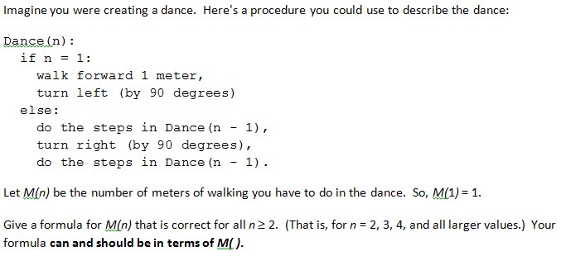
Notes:
Quotes:
#1: M(n) = 2 M(n-1) + 1 “We first do 1 step then M(n-1) steps then M(n-1) steps”
#4: M(n) = 2M(n-1) + 1 (not sure why in this case)
#2: review for 2M(n-1) +1 misconception??
#9: review for 2M(n-1) +1 misconception??
#7: M(n) = M(n-1) (that is, M(n) = 1) “If I’m correct, it would always be reduced to 1.”
#6: M(n) = M(n-1) “When they eventually bottom out, they just walk forward 1m.”
#7: M(n) is undefined “It’ll never even get to the next one [call to M(n-1)]. Hm.. that’s weird.”
#10: M(n) = 2; don’t understand why
#5: M(n) is proportional to n^2 “Kind of looks like n^2 because you’re getting two recursive calls.”
#15-21: review?
#22-24 all had interesting statements on this. Each one proposed and (IIRC) all but one eventually settled on one of the misconceptions, despite being late-CPSC 320 students.

Slide 12
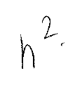
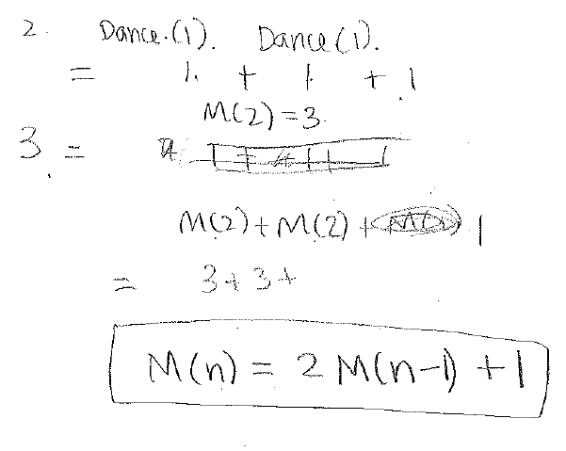
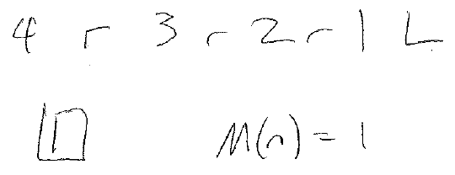
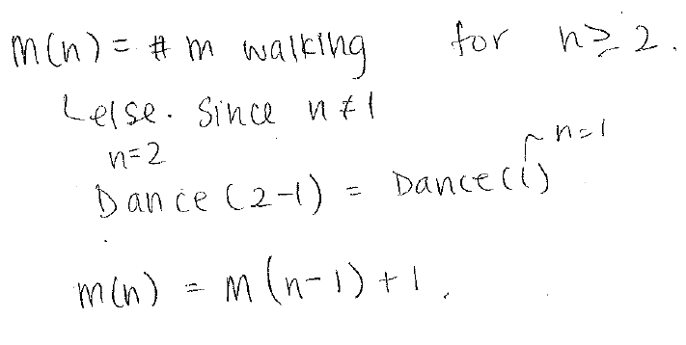
4, 221 CIP
5, 320 CIP
#1: “We first do one step, then M(n-1) steps…”
(320 CIP)
9, completed 121; 221 CIP?? 121 grade?
15, 121 CIP (1/2 way)
“We first do one step, then M(n-1) steps…”
“...it would always be reduced to 1 ultimately. Since it’s just Dance(n-1) and then it’s just turning not really moving…”
7, completed 121; 221 CIP?? 121 grade?
“If I’m correct, it would always be reduced to 1 ultimately. Since it’s just Dance(n-1) and then it’s just turning not really moving… and that wouldn’t affect …. the number of metres that I’ve walked.”
19, 121 CIP (1/2 way)
“Starting at 4, you.. Do 4, turn right, do 3, turn right, do 2, turn right, walk forward 1 m, turn left.” “So only at one point will I do 1, that’s when you walk forward. So M(n) = 1.”

Slide 13
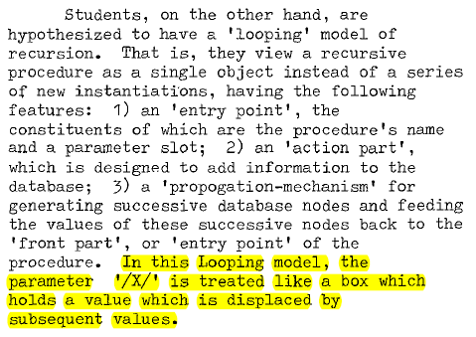
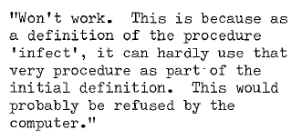
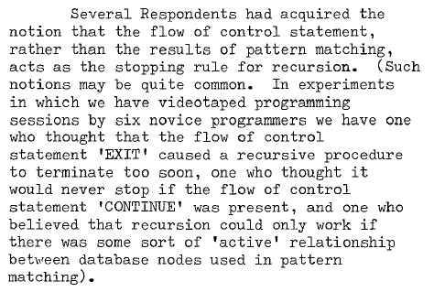
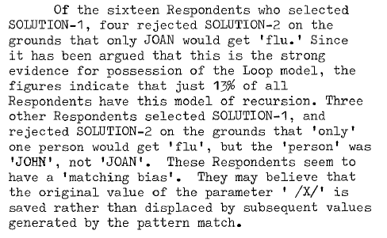
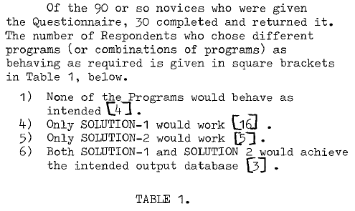
Kahney, CHI 1983
“If I’m correct, it would always be reduced to 1 ultimately. Since it’s just Dance(n-1) and then it’s just turning not really moving… and that wouldn’t affect …. the number of metres that I’ve walked.”
“Starting at 4, you.. Do 4, turn right, do 3, turn right, do 2, turn right, walk forward 1 m, turn left. … So only at one point will I do 1, that’s when you walk forward. So M(n) = 1.”

Slide 14
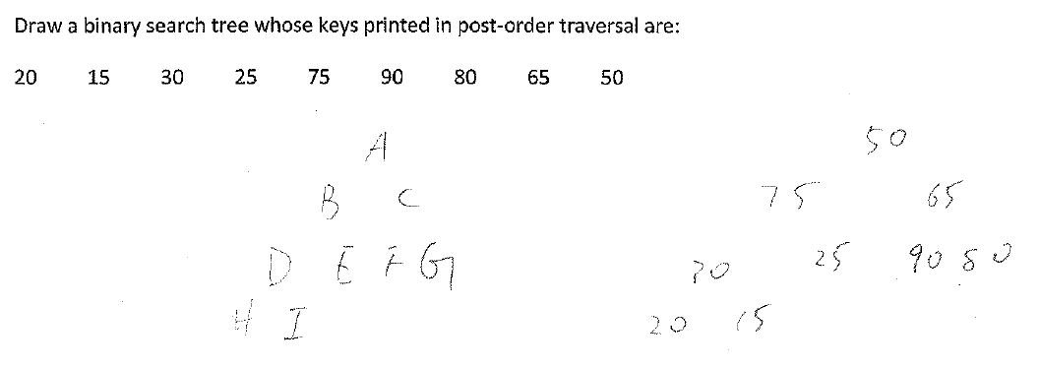
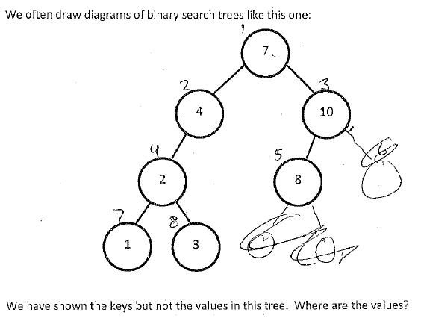
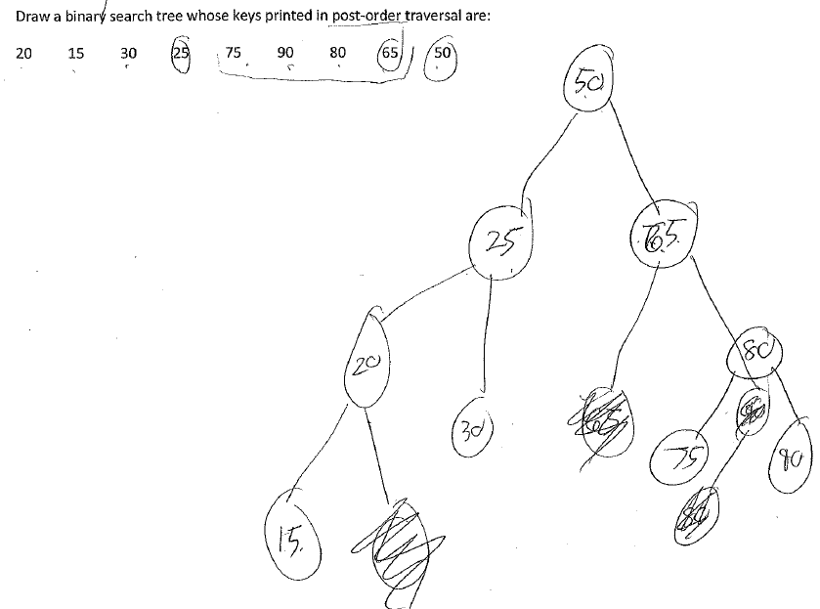
Same student as example: "The smallest, all smallest values should always be at the bottom.. at the top. [pause] Well.. not necessarily, that's for a heap. Um.. hm.. [pause] I'm not sure if that applies for binary trees as well.
Heap/BST Confusion? Never hinted at by my faculty i’views…
In answer to “Why isn’t this a BST?”
“it's because … the right only has depth 1, while the left has depth 3. … BSTs should have both sides equal depth. Is that a heap? It doesn't matter.”
These are the keys; so the values should be 1, 2, 3, 4, 5, so they're index values right.. 6, 7, 8.. um.. there should be index values
Notes:
The post-order traversal responses are (again) different students.
Ref to sigcse-2012-detecting-understanding-ds-algo-miscons-danielsiek, sigcse-2013-algo-ds-miscon-instrument-follow-up

Slide 15
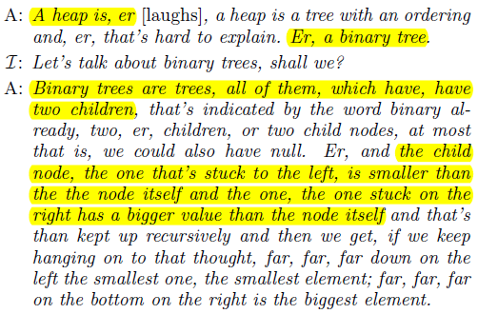
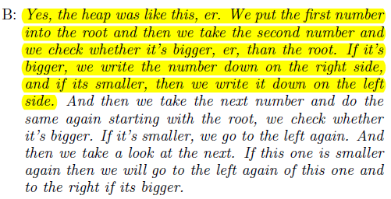
Danielsiek et al. SIGCSE 2012

